Slide 1

The devolpment of the
video game industry

Slide 2

SPACEWAR

Slide 3
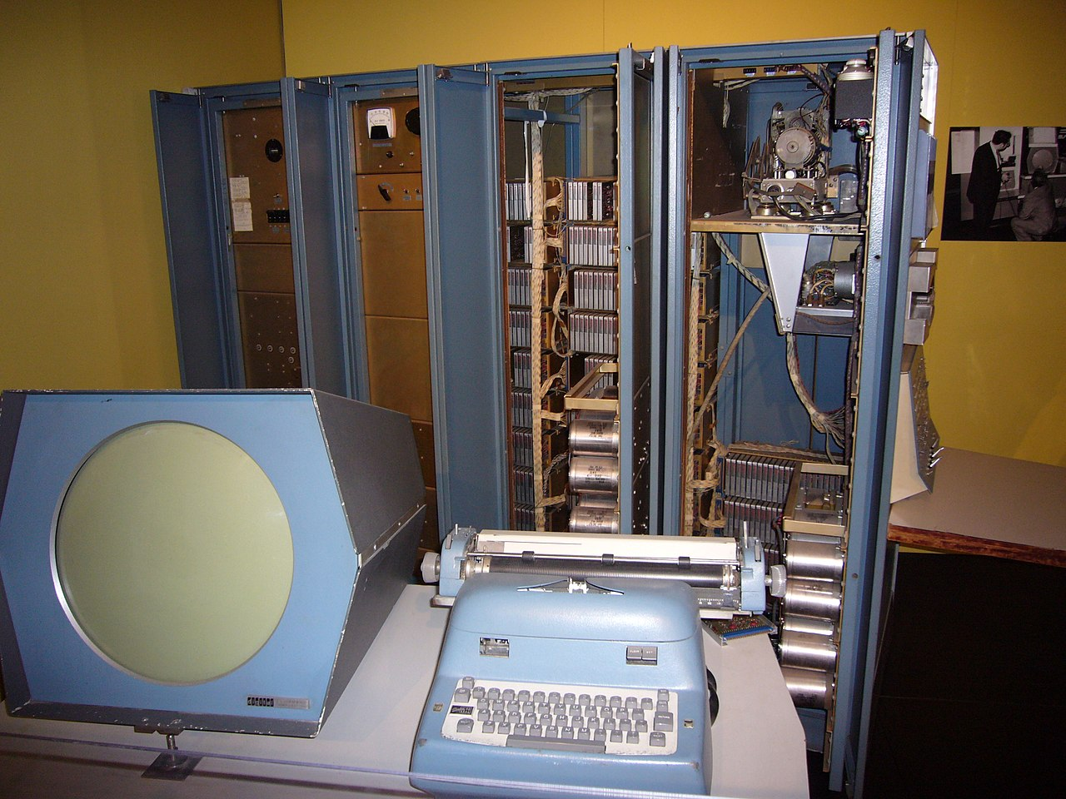

Slide 4


Slide 5
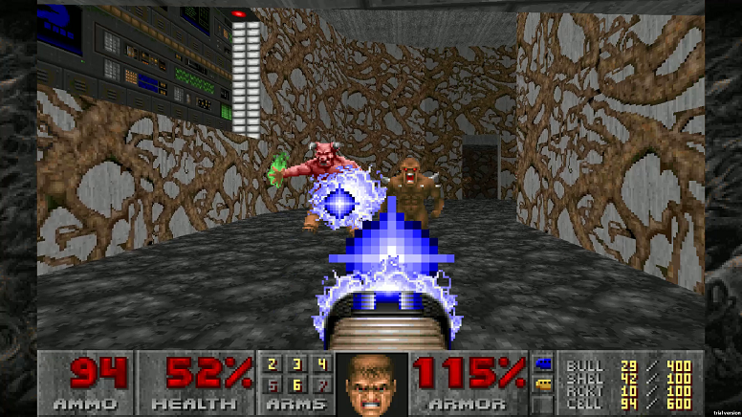
DOOM

Slide 6


Slide 7


